Slide 1

EKF-PF Based Localisation Comparison for Different System Parameters
KERİM MORAL
518191043
KOM 613E - Probabilistics Methods in Robotics
Prof. Dr. Hakan TEMELTAŞ

Slide 2

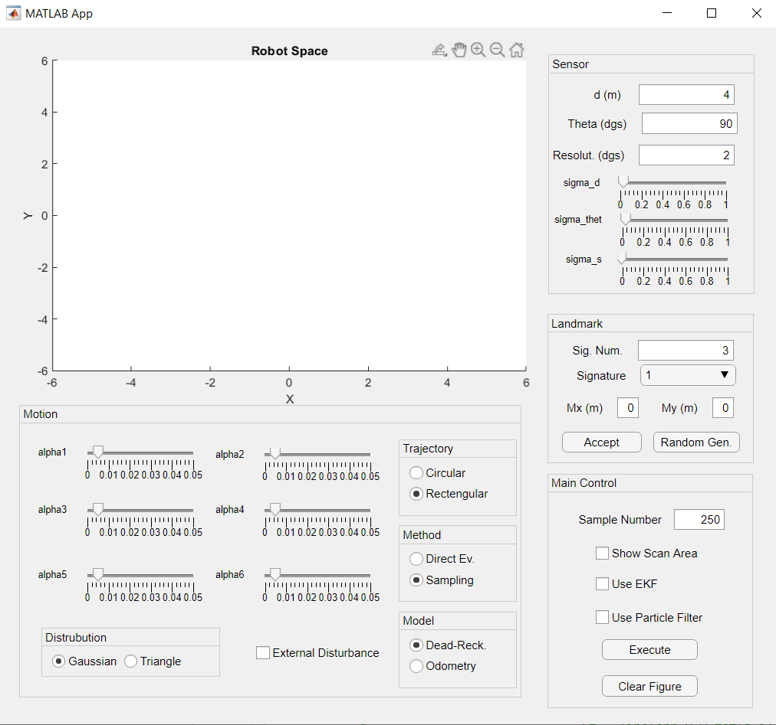
Introduction
Extended Kalman Filter (EKF) implementation was already done in previous Home works.
With this work, a Particle Filter (PF) algorithm has been designed and similarities and differences will tried to be highlighted.

Slide 3
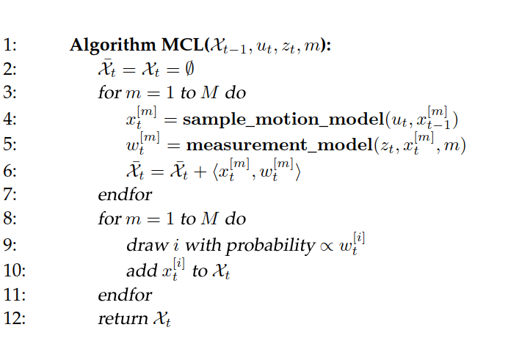
Particle Filter Algorithm

Slide 4

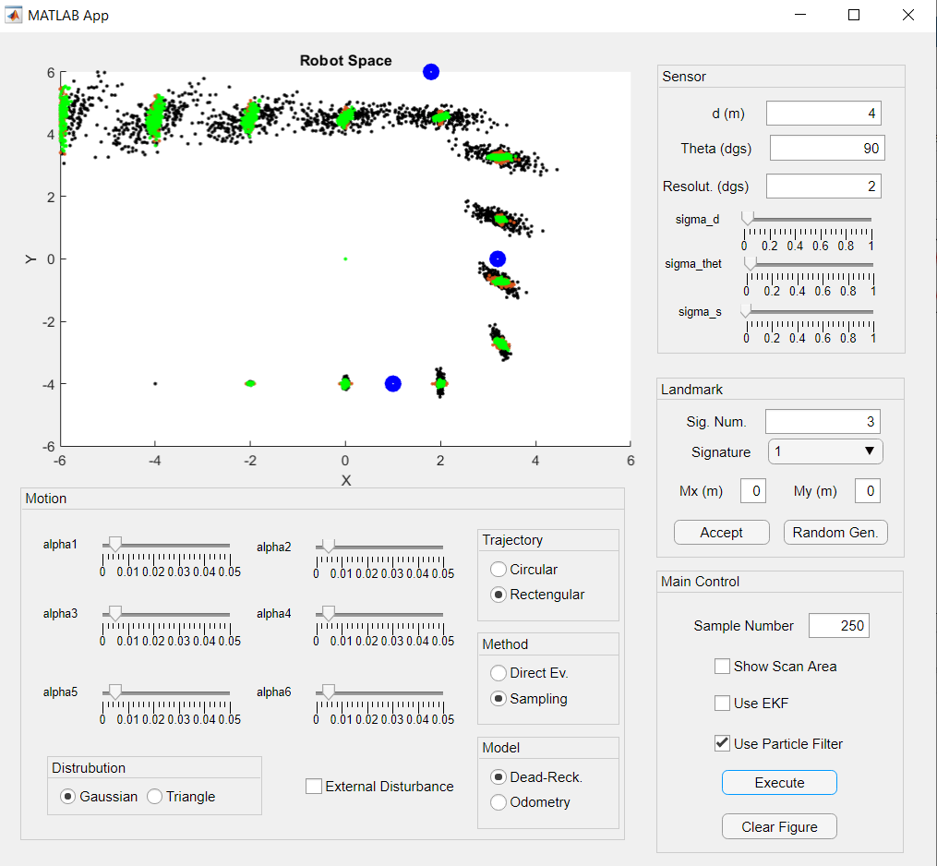
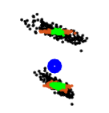
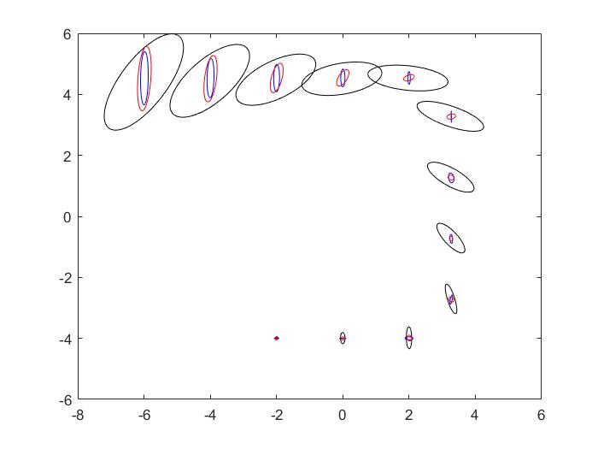
EKF-PF Comparison with Gaussian Distribution
Sample number has been taken as 250.
Black dots are platform positions without any filtering, brown dots belong to EKF and green dots are PF.

Slide 5
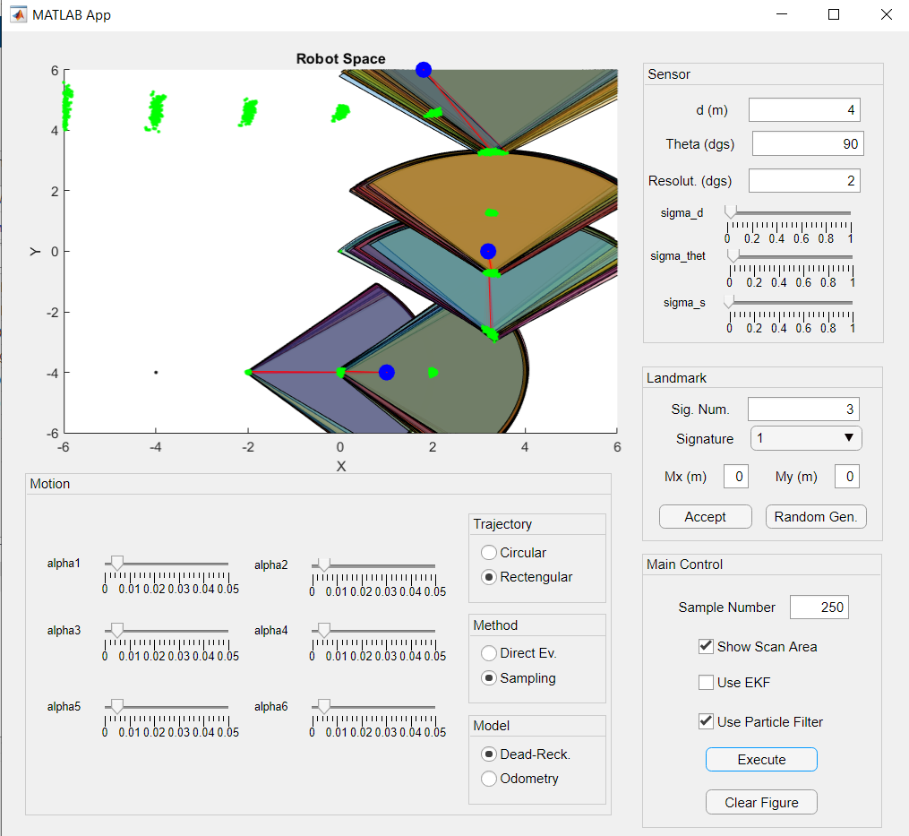
Closer Look to PF Results

Slide 6
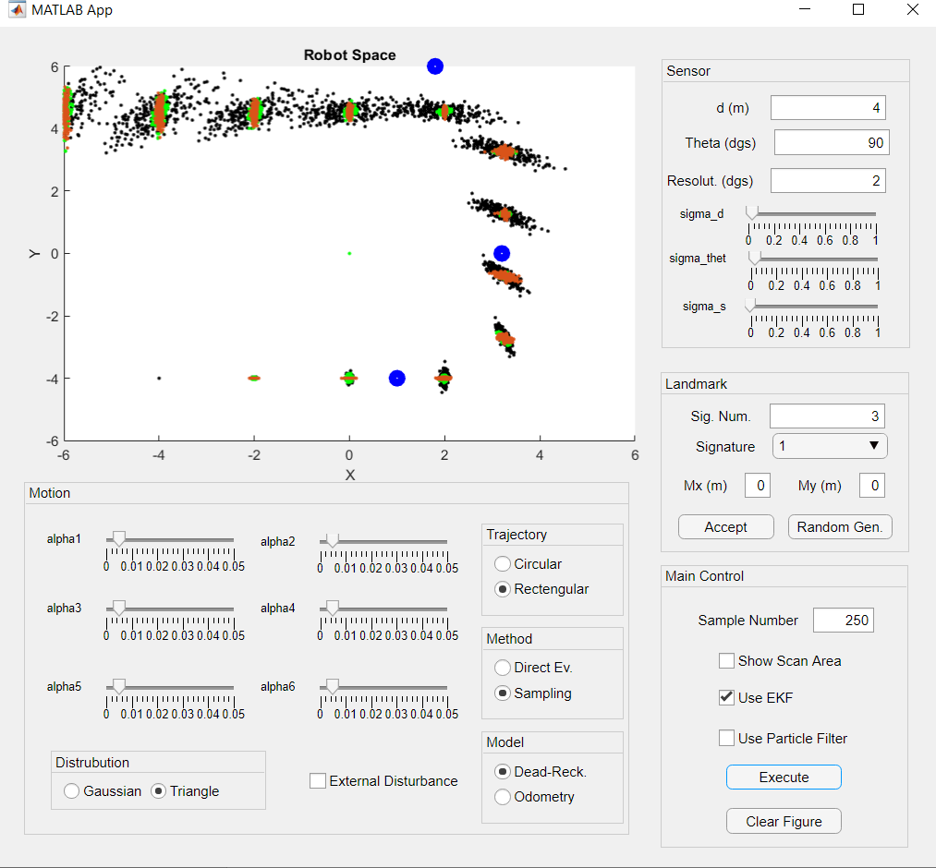
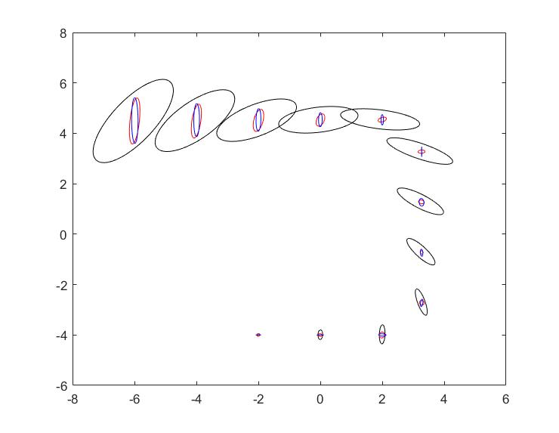
3. EKF-PF Comparison with Triangular Distribution

Slide 7
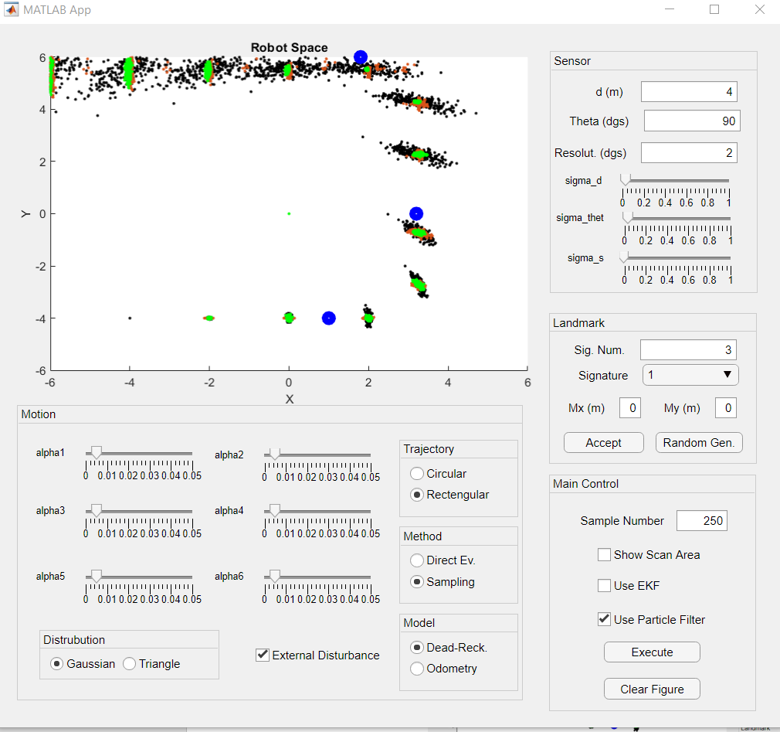
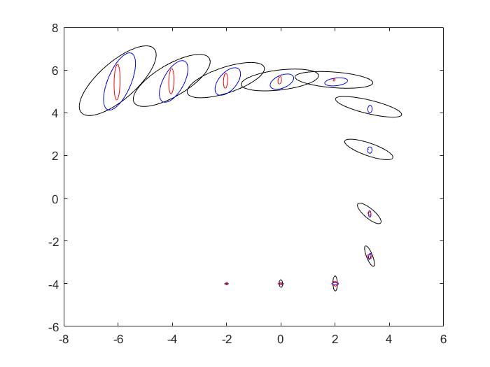
4. EKF-PF Comparison with External Disturbance

Slide 8
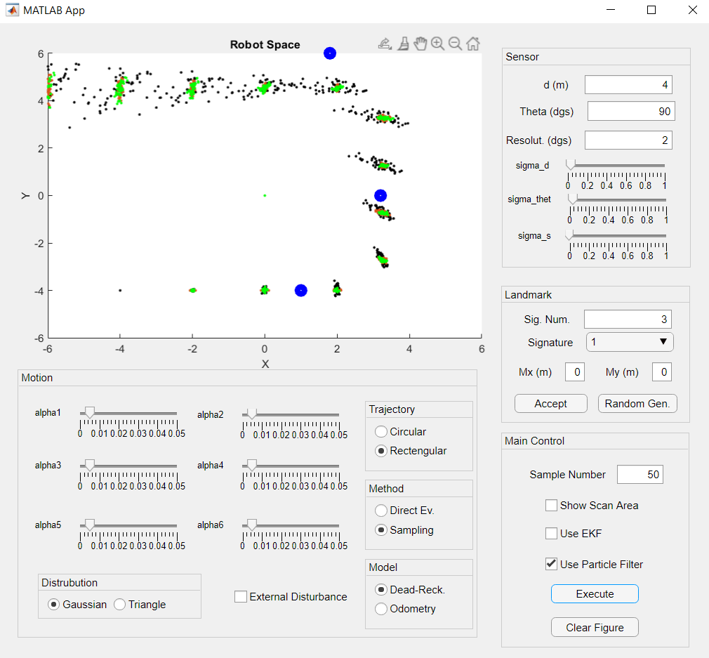
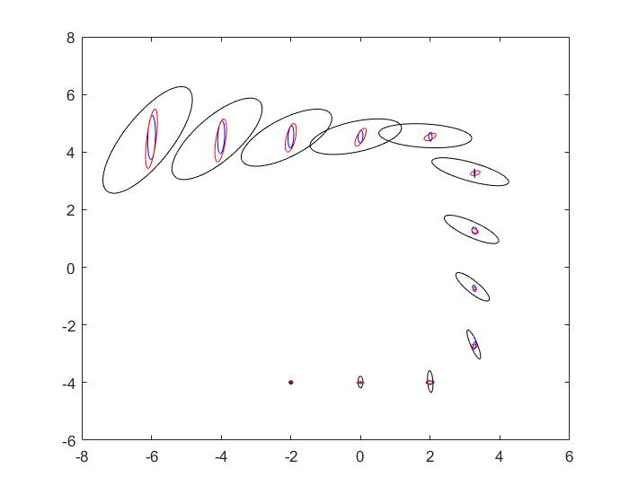
5. EKF-PF Comparison with Less Particles

Slide 9
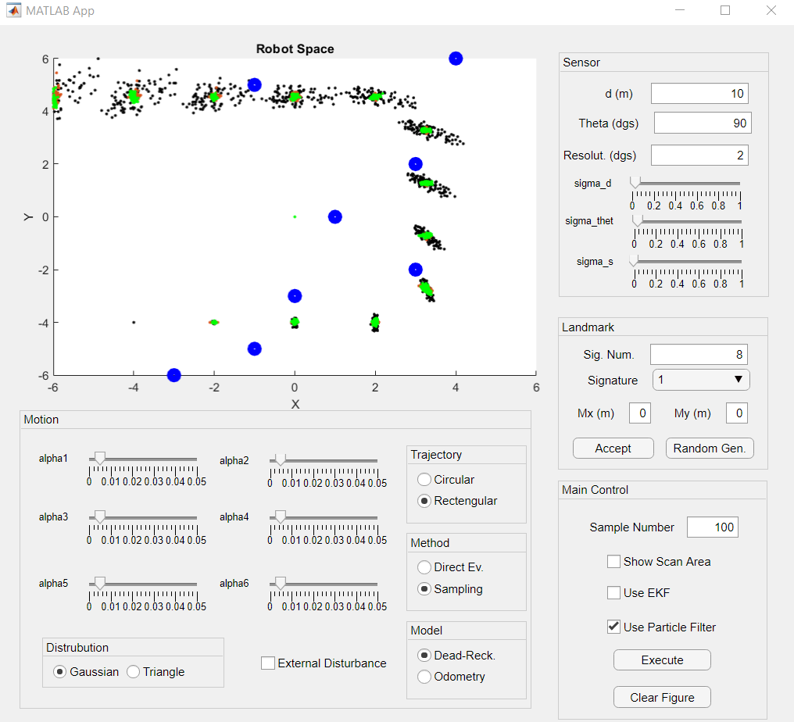
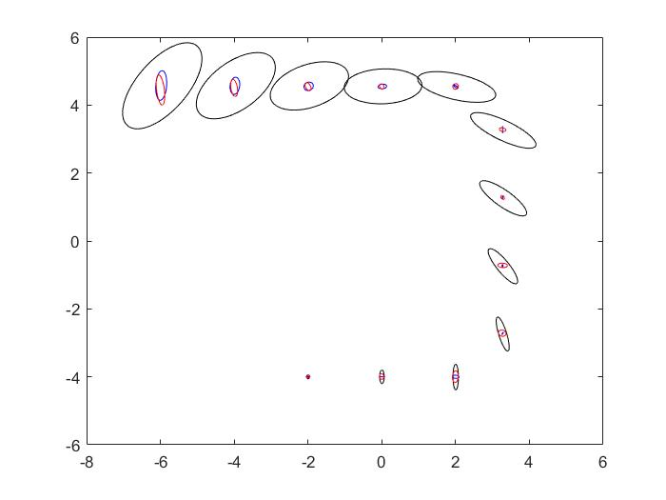
6. EKF-PF Comparison with More Objects and Increased Sensor Range

Slide 10
Thank You for Listening

